Slide 1
Protein Structure Prediction
Template Free Modeling using Simulated Annealing and Consensus Scoring

Slide 2
Agenda
Introduction to Template Free Modeling
Fragment database construction
Fragment database querying
Target structure initialization
Introduction to Simulated Annealing
Consensus scoring for model acceptance Unique
Building decoys
Decoy evaluation
Who does what

Slide 3
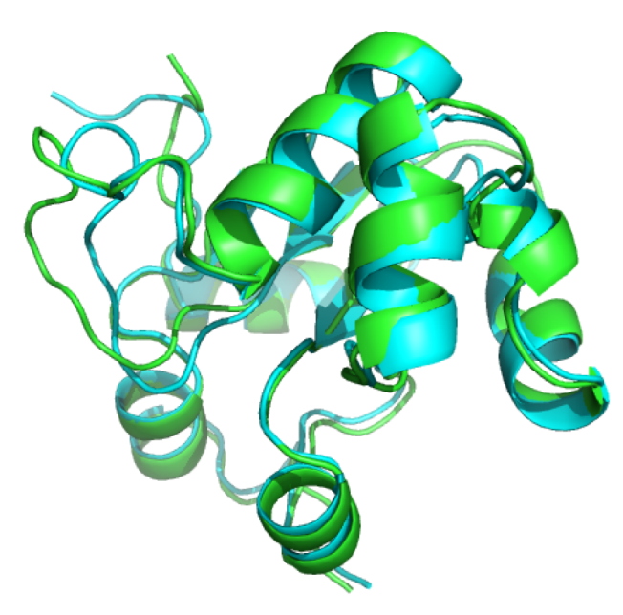
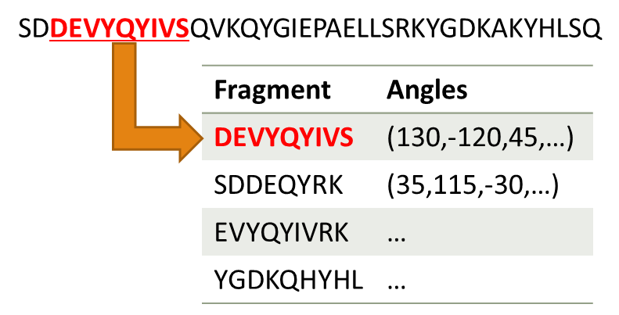
Introduction to Template Free Modelling
Knowledge of a protein’s structure is important
Sometimes similar proteins can be used as templates
Not all proteins have templates
We can use fragments of other known proteins instead
Protein Template

Slide 4
SDDEVYQYIVSQVKQYGIEPAELLSRKYGDKAKYHLSQ
Fragment | Angles
DEVYQYIVS | (130,-120,45,…)
SDDEQYRK | (35,115,-30,…)
EVYQYIVRK | …
YGDKQHYHL | …
s ← s0; e ← E(s) // Initial state, energy.
sbest ← s; ebest ← e // Initial "best" solution.
k ← 0 // Energy evaluation count.
while k < kmax and e > emax // While time left & not good enough:
T ← temperature(k/kmax) // Temperature calculation.
snew ← neighbour(s) // Pick some neighbour.
enew ← E(snew) // Compute its energy.
if P(e, enew, T) > random() then // Should we move to it?
s ← snew; e ← enew // Yes, change state.
if enew < ebest then // Is this a new best?
sbest ← snew; ebest ← enew // Save 'new neighbour' to 'best found'.
k ← k + 1 // One more evaluation done
return sbest // Return the best solution found.
DEVYQYIVSQVKQYGIKYHLSQ
DEVYQYIVSQVKQYGIKYHLSQ
DEVYQYIVSQVKQYGIKYHLSQ
Fragment | Angles
DEVYQYIVS | (130,-120,45,…)
QVKQYGIKY | (35,115,-30,…)
YGIKYHLSQ | …

Slide 5
# Simulated Annealing for Score Maximization
WHILE count < max_steps:
temperature := temperature - cooling_rate
candidate := solution.neighbor()
# Get score deltas
score_difference1 := score1(solution) - score1(candidate)
score_difference2 := score2(solution) - score2(candidate)
score_difference3 := score3(solution) - score3(candidate)
# Two or more candidate scores are worse than current solution
IF two_or_more(score_differences > 0):
# Normalize score differences based on their scoring methods
score_difference := normalize_and_sum(score_differences)
# Higher the temp, closer prob_to_accept gets to 1
prob_to_accept := e^(score_difference/temperature)
# Select from uniform distribution. If higher than
# prob_to_accept skip that candidate and try again
IF prob_to_accept > random():
continue
END
END
solution := candidate
END
# Simulated Annealing for Score Maximization
WHILE count < max_steps:
temperature := temperature - cooling_rate
candidate := solution.neighbor()
score_difference := score(solution) - score(candidate)
# Candidate score is worse than current solution
IF score_difference > 0:
# Higher the temp, closer prob_to_accept gets to 1
prob_to_accept := e^(score_difference/temperature)
# Select from uniform distribution. If higher than
# prob_to_accept skip that candidate and try again
IF prob_to_accept > random():
continue
END
END
solution := candidate
END

Slide 6
Fragment database construction
How do we get from PDB to DB?
Convert PDB into residue-torsion pairs
Sliding window along new list
AA | S | D | D | E | Y | Q | Y | I | …
Phi | 120 | 30 | -60 | -75 | 25 | 115 | -145 | 65 | …
Psi | 160 | 75 | 85 | -15 | -10 | 30 | 25 | -30 | …
AA | S | D | D | E | Y | Q | Y | I | …
Phi | 120 | 30 | -60 | -75 | 25 | 115 | -145 | 65 | …
Psi | 160 | 75 | 85 | -15 | -10 | 30 | 25 | -30 | …

Slide 7
Fragment database querying
Multiple choices, some simple, some hard
Choice 1: Complete sequence match
For each segment (length 3 or 9) do a query for a complete match in the database
Randomly select from list of matches
Drawback: Segment may not exist in the database. 20^9, or ~5x10^11 possible combinations
Possible extension: Include secondary structure and solvent accessibility of sequence in search
Choice 2: Query based on edit distance, BLOSUM62
For each segment (length 3 or 9) run BLOSUM62 against each and find match with lowest edit distance
Drawback: High computation time. 9^2 comparisons + table lookup
Possible speedup: Run Choice 1 first. Only use this method if no complete matches are found
Choice 3: DB Clustering
Attempt to cluster fragments based on feature similarity
Drawback: Not straight forward. Large amount of classification work required prior to use

Slide 8
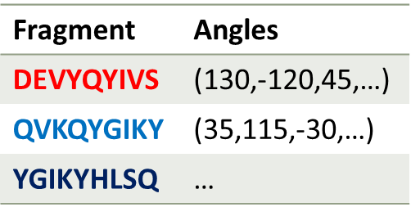



Target structure initialization
Unlike with Template Based Modelling, initialization is not very important
For each non-overlapping chunk of 9 from target sequence, find decent match in Fragment DB
When we reach the end, take the final 9 and find a decent match in Fragment DB

Slide 9
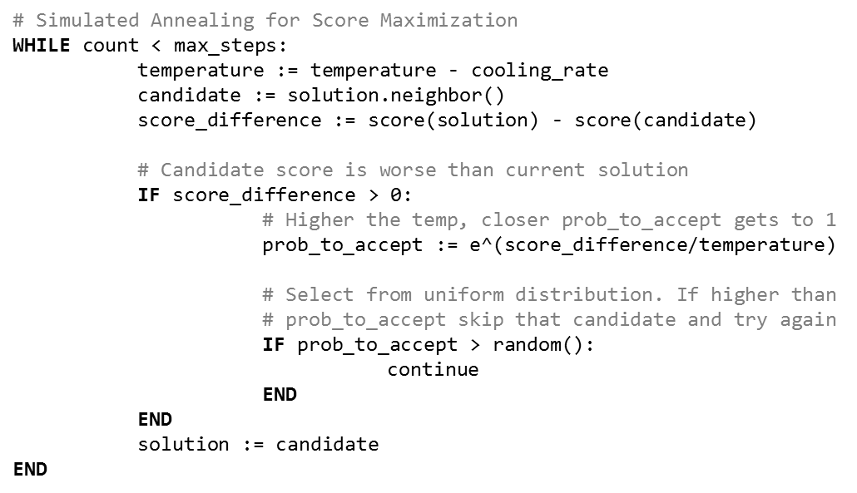
Introduction to Simulated Annealing
Idea: Allow mistakes when high energy (temperature), then slowly become more strict as energy lowers
In each cycle:
Grab the current solution’s neighbor
If the neighbor’s score is better, use the neighbor as the current solution
If it’s not, select it with a probability based on the current temperature, e^(-change/temperature) when trying to minimize, e^(change/temperature) otherwise

Slide 10
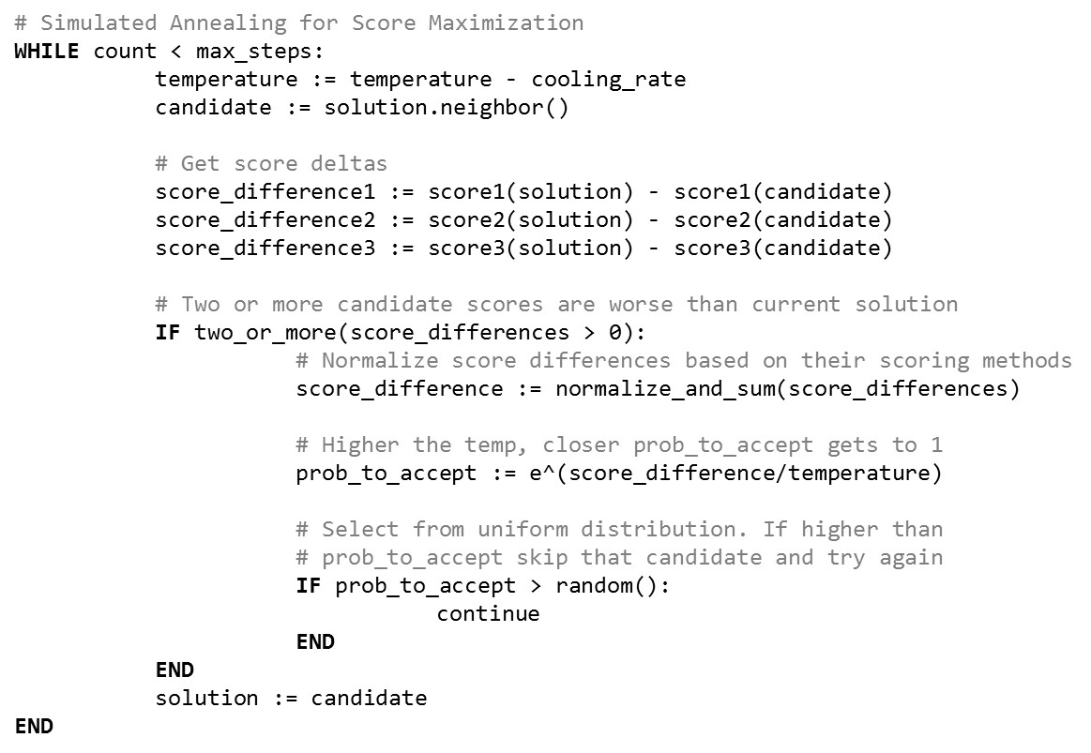
Consensus scoring for model acceptance
Unique
Consensus is becoming popular in machine learning recently
Ability to improve classification based on multiple different methods
Modifying it for Simulated Annealing scoring
Use three scoring techniques:
D-fire
RW-potential
Rosetta
If score improves for 2/3, accept
Otherwise normalize and sum, then accept according to temperature based probability

Slide 11
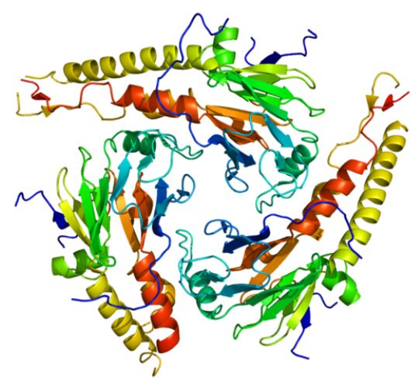
Building decoys
Important for determining algorithm quality
Build 100 decoys, recording scores from Simulated Annealing
Collection is scored and sorted
Collection’s rmsd is calculated against native structure
Accuracy of algorithm is determined

Slide 12
Decoy evaluation
Target | <3Å | <4Å | <5Å | <6Å | Decoys
T0644 | 12 | 52 | 65 | 89 | 100
T0645 | 2 | 3 | 5 | 11 | 100
T0646 | 54 | 67 | 81 | 95 | 100
… | … | … | … | … | …

Slide 13
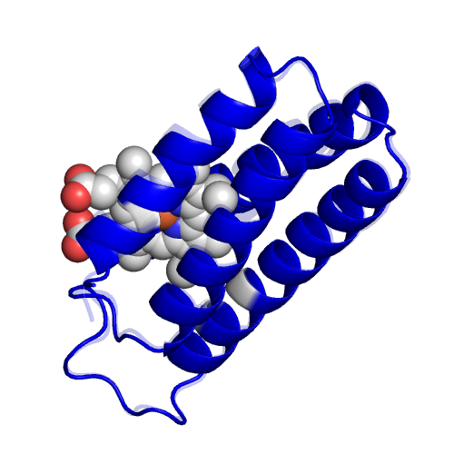
Visualization
Movie from PDBs
Save off every 100th PDB (out of 10,000 created) and store it off
After sorting, use tools to create a movie of the top-scoring protein
End with an overlay of it and its native structure along with the RMSD/TM-score for comparison

Slide 14
Architecture
Fragment DB
Load in PDBs
Create fragments
Convert to dihedrals
Store in DB
Initialize Decoy
Simulated Annealing
Select Neighbor
Compare scores
Accept/Reject
Repeat until cool
Add to list of decoys
100x
Convert to PDB
Score PDB
Normalize scores
Return normalized sum
Dfire Energy
RW potential
Rosetta

Slide 15
Architecture
Fragment DB
Load in PDBs
Create fragments
Convert to dihedrals
Store in DB
Initialize Decoy
Simulated Annealing
Select Neighbor
Compare scores
Accept/Reject
Repeat until cool
Add to list of decoys
100x
Convert to PDB
Dfire Score PDB
Return score

Slide 16
Implementation
Language: Python 3.3 x86
Temperature/Cycles: 25,000/10,000
Tools: Dfire, Rosetta, rama/lipa for torsion angle/pdb conversion, TM-score, RW-potential
Libraries: biopython, numpy, scipy, sqlite3

Slide 17
Potential Issues/Solutions
Issue: Fragment DB too difficult to create:
Reason: Gathering enough PDBs to create a large enough database may not be possible. Organization/access may be too complicated.
Solution: Use pre-built fragment database created by Rosetta
Issue: Normalization between multiple scores not possible
Reason: Open-ended scores (not a set range) may keep ranges from being normalized.
Solution: Remove those scores and either keep them out or replace them. Worst case scenario we go to a single score

Slide 18
Who does what…
Project Coordinator
Name | Handle
Caiwei Wang | cwwmoment
Team Members
Name | Handle | Is Doing
Xiaokai Qian | qxk2310 | Testing, Coding
Haipei Fan | happyfhp | Documentation
Puneet Gaddam | pg7b2 | Evaluation, Visualization
Sean Lander | slander36 | PPTs, Coding
Brett Koonce | asparagui | Report, Coding

Slide 19
Questions?

